Slide 1
Falls detection by three classifier approach
曾歆勋 11210162 董广念11849058 王耕昕 11510189

Slide 2
Outline
Problem Introduction
Three Approach
Support Vector Machine-董广念
Neural Network-王耕昕
Decision Tree-曾歆勋
Conclusion

Slide 3
Problem Introduction
This dataset is about fall detection, having 6 attribute and 6 label as follow.
Attribute | Meaning
SL | Sugar level
Time | Monitoring time
BP | Blood pressure
CIRCLUATION | Blood circulation
HR | Heart beat rate
EEG | EEG monitoring rate
Label | Meaning | count
0 | Standing | 2813
1 | Walking | 307
2 | Sitting | 1528
3 | Falling | 2191
4 | Cramps | 2133
5 | Running | 1028

Slide 4
Outline for each model
Model information
Preprocessing
Hyperparameter
Validation

Slide 5
Support vector machine
Tool
scikit-learn
Algorithm
Gaussian kernel, ovo
Performance
69.9% ranking: 4/7
Training time
Seconds, positive correlation with parameter C
e.g. C=215 t=6s, C=1000 t=10s, C=200000 t=120s
Searching time
3 hours

Slide 6
Preprocessing
Feature selection
In this work, no.
Normalization
need
Dimension reduction
Yes
Outlier deletion
need

Slide 7
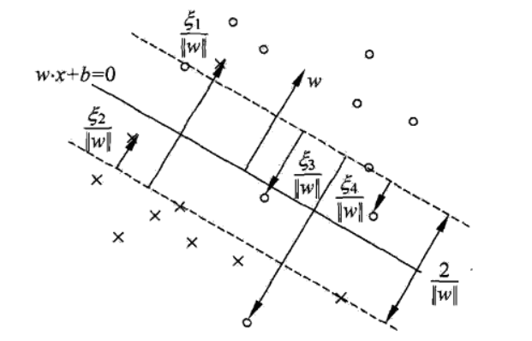
Support vector machine
Soft/hard margin
Hyper parameter: C
Kernel
Hyper parameter: gamma
Multiclass classification

Slide 8
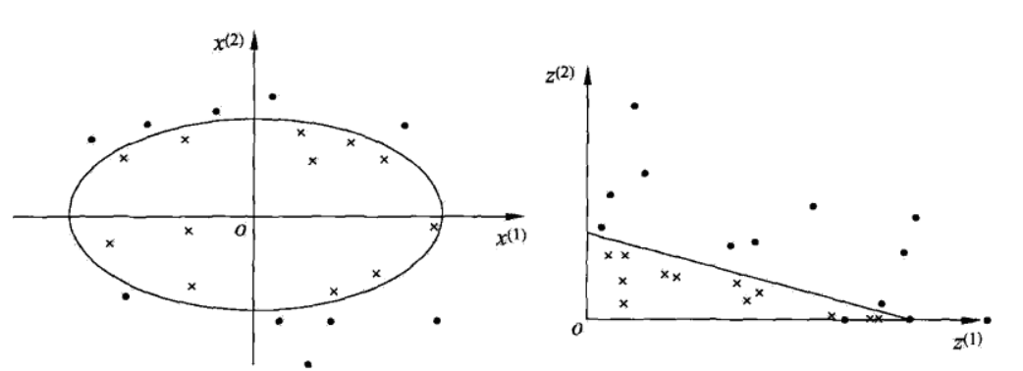
Support vector machine
Soft/hard margin
Hyper parameter: C
Kernel
Hyper parameter: gamma
Multiclass classification

Slide 9
Support vector machine
Soft/hard margin
Hyper parameter: C
Kernel
Hyper parameter: gamma
Multiclass classification
one-vs-rest
one-vs-one

Slide 10
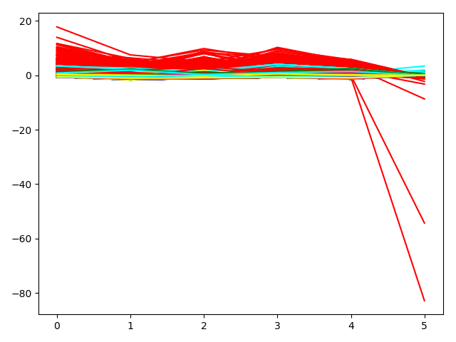
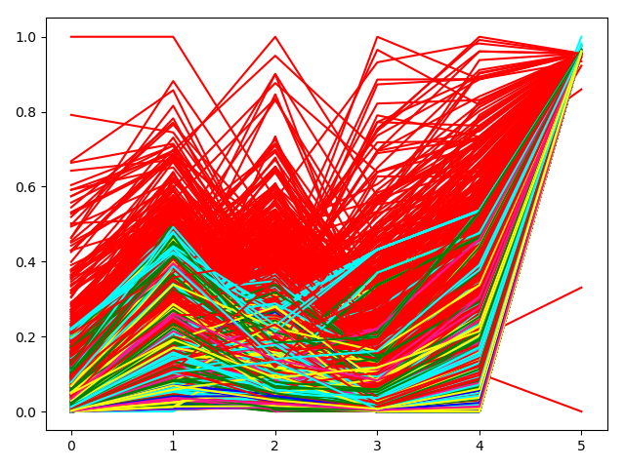
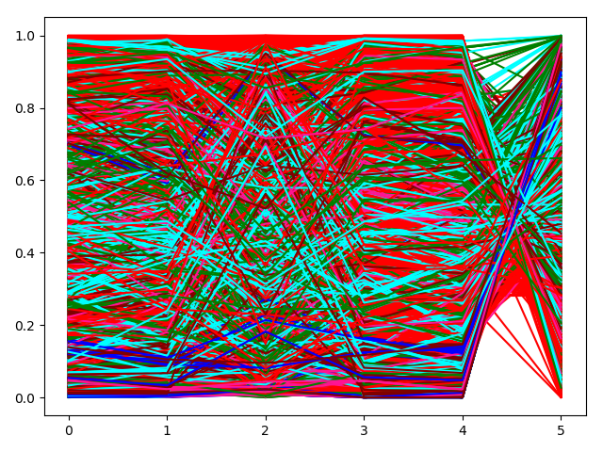
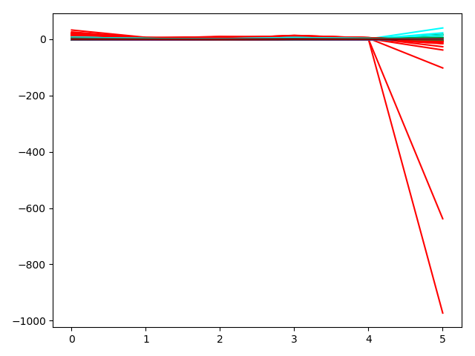
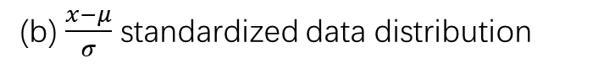
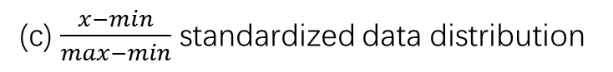
Normalization
value
value
value
methods | accuracy
(a) | 0.686
(b) | 0.669
(c) | 0.689
(d) | 0.697
attributes
attributes
(b) $\frac{x−μ}{σ}$ standardized data distribution
(c) $\frac{x−min}{max−min}$ standardized data distribution
value
value
attributes
attributes
(d) Quantile transformed data distribution
(e) Robustscaler standardized data distribution

Slide 11
Neural Network
Parameter | Type | Value
Hidden Nodes | Integer | 238,237,239,237
L2 regularization | Float | 0.0007
Learning rate | Float | 0.00424732
Optimizer | Enum | Adam
Betas | Float | 0.88358924, 0.94203335
Dropout | Float | 0.5
Tool
Pytorch with 1 GPU
Training time
10mins
Searching time
Few days
Preprocessing:
normalization
Hyperparameters tuning
Bayesian Optimization (贝叶斯优化)
Performance:
72%

Slide 12
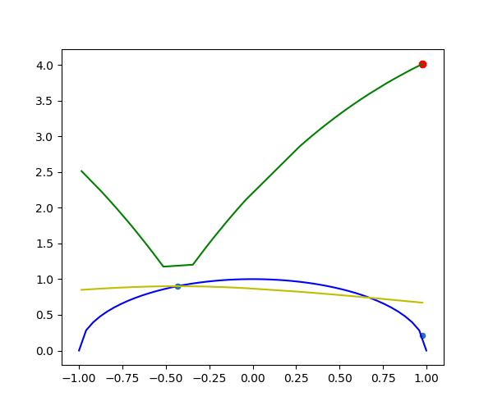
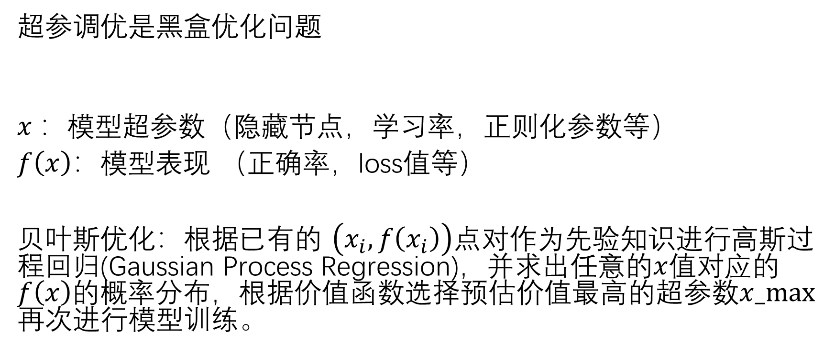
Bayesian Optimization
超参调优是黑盒优化问题
$x$：模型超参数（隐藏节点，学习率，正则化参数等）
$f\left(x\right)$：模型表现 （正确率，loss值等）
贝叶斯优化：根据已有的 $\left(x_{i},f\left(x_{i}\right)\right)$点对作为先验知识进行高斯过程回归(Gaussian Process Regression)，并求出任意的$x$值对应的$f\left(x\right)$的概率分布，根据价值函数选择预估价值最高的超参数$x_max⁡$再次进行模型训练。

Slide 13
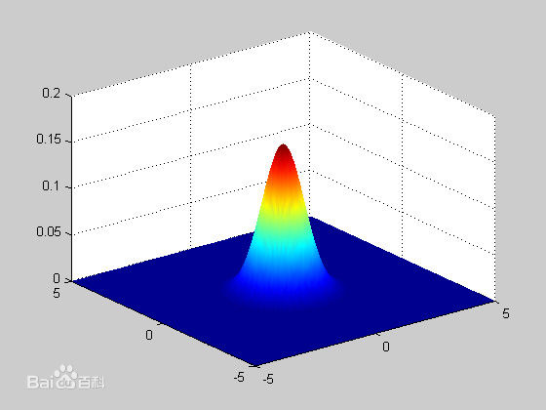
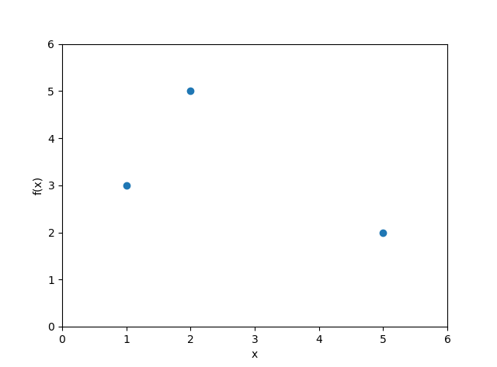
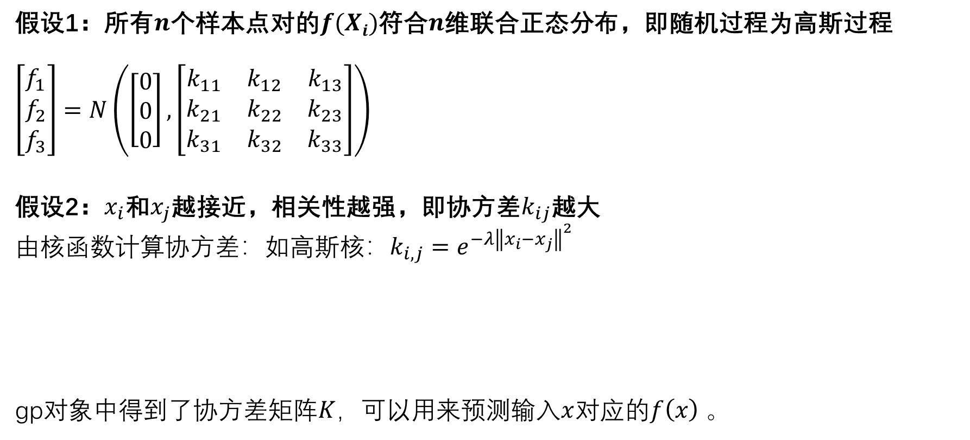
高斯过程回归(Gaussian Process Regression)
假设1：所有$n$个样本点对的$f(Xi)$符合$n$维联合正态分布，即随机过程为高斯过程
$$\left[\begin{matrix}f_{1} \\ f_{2} \\ f_{3}\end{matrix}\right]=N\left(\left[\begin{matrix}0 \\ 0 \\ 0\end{matrix}\right],\left[\begin{matrix}k_{11} & k_{12} & k_{13} \\ k_{21} & k_{22} & k_{23} \\ k_{31} & k_{32} & k_{33}\end{matrix}\right]\right)$$
假设2：$x_{i}$和$x_{j}$越接近，相关性越强，即协方差$k_{ij}$越大
由核函数计算协方差：如高斯核：$k_{i,j}=ⅇ^{−λ{\left\|x_{i}−x_{j}\right\|}^{2}}$
gp对象中得到了协方差矩阵$K$，可以用来预测输入$x$对应的$f\left(x\right)$。
1 kernel = Matern()
2 gp = GaussianProcessRegressor(kernel) 3 gp.fit(xs, ys)

Slide 14
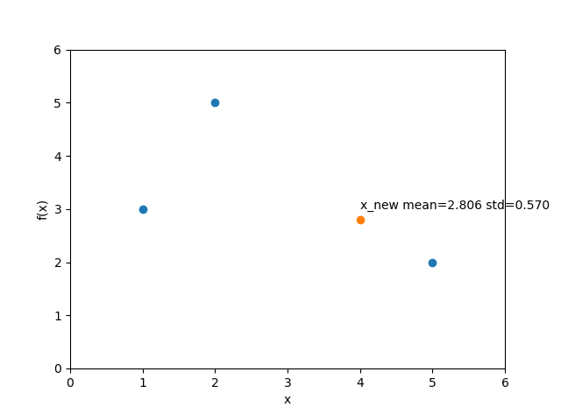
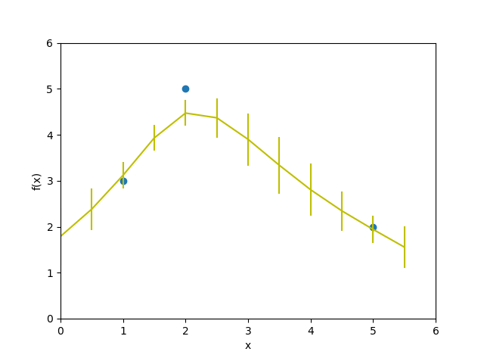
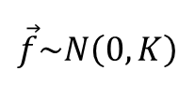
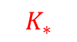

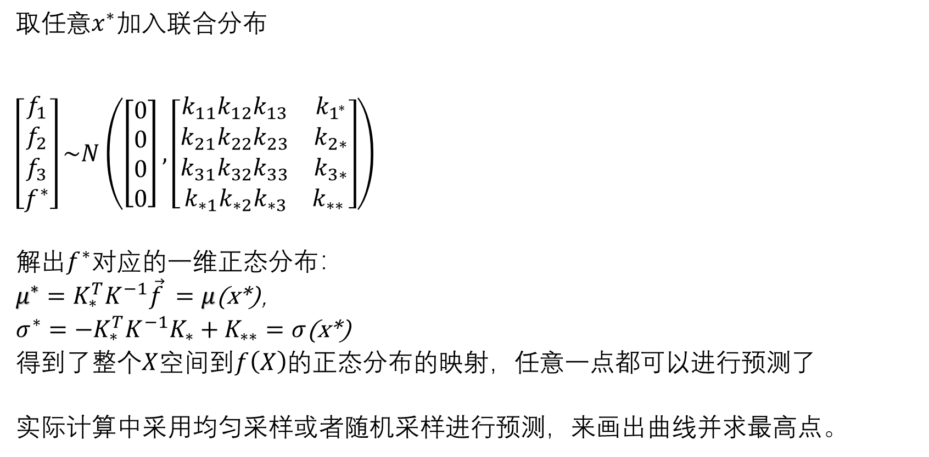
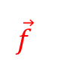
如何预测超参效果？
取任意$x^{∗}$加入联合分布
$$\left[\begin{matrix}f_{1} \\ f_{2} \\ f_{3} \\ f^{∗}\end{matrix}\right]\sim N\left(\left[\begin{matrix}0 \\ 0 \\ 0 \\ 0\end{matrix}\right],\left[\begin{aligned}\begin{matrix}k_{11}k_{12}k_{13} & k_{1^{∗}} \\ k_{21}k_{22}k_{23} & k_{2∗} \\ k_{31}k_{32}k_{33} & k_{3∗}\end{matrix} \\ k_{∗1}k_{∗2}k_{∗3 }{ k}_{∗∗}\end{aligned}\right]\right)$$
解出$f^{∗}对应$的一维正态分布：
$μ^{∗}=K_{∗}^{T}K^{−1}\vec{f} =μ$(x*)，
$σ^{∗}=−K_{∗}^{T}K^{−1}K_{∗}+K_{∗∗}=σ$(x*)
得到了整个$X$空间到$f\left(X\right)$的正态分布的映射，任意一点都可以进行预测了
实际计算中采用均匀采样或者随机采样进行预测，来画出曲线并求最高点。
$$\vec{f}$$
$$K$$
$$K_{∗}^{ }$$
1
$$\vec{f}\sim N\left(0,K\right)$$
1 mean, std = gp.predict(x_new)

Slide 15
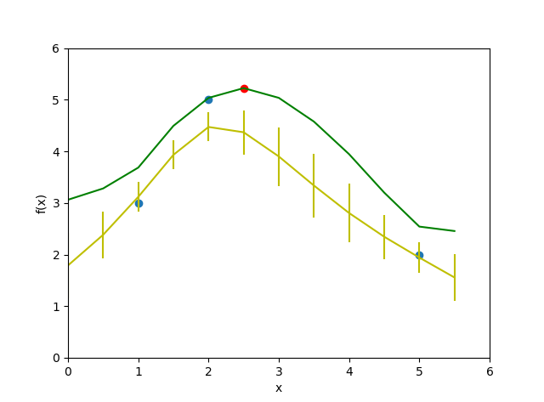
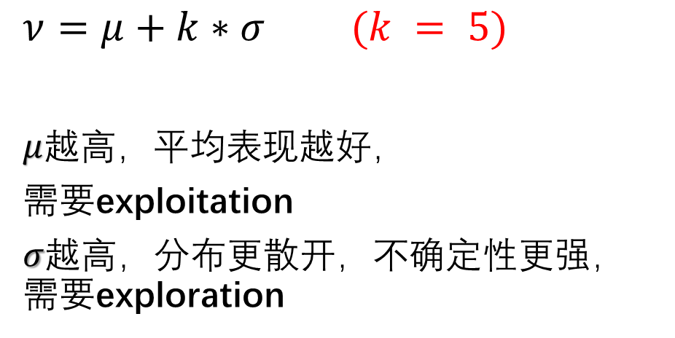
根据价值函数选取超参
$ν=μ+k∗σ$ $(k = 5)$
$μ$越高，平均表现越好，
需要exploitation
$σ$越高，分布更散开，不确定性更强，需要exploration
1 values = mean + KAPPA * std 2 x_max = x_tries[values.argmax()]
3 y_new = train(x_max)
加入新的点对$(x_max, y_new)$，再进行新一轮的高斯过程回归，不断循环。

Slide 16
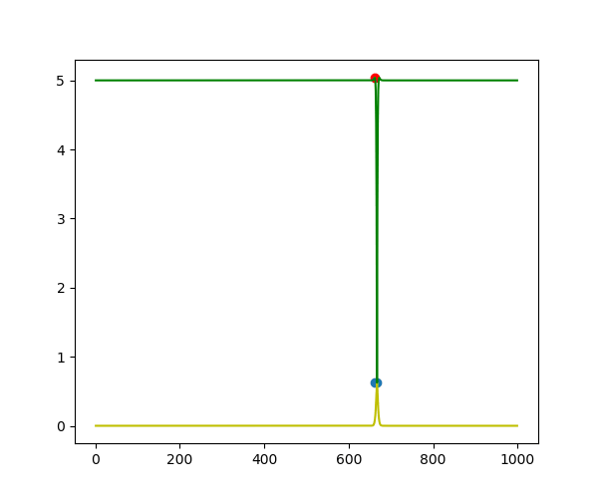
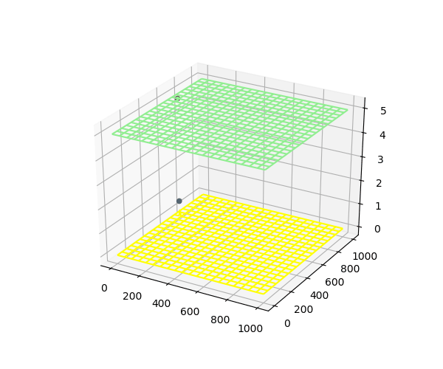
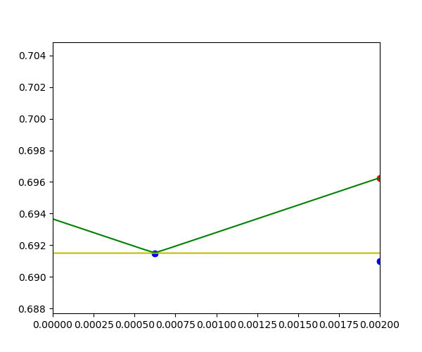
Examples
正确率/价值
正确率/价值
正确率/价值
一层隐藏节点
两层隐藏节点
L2正则化参数

Slide 17
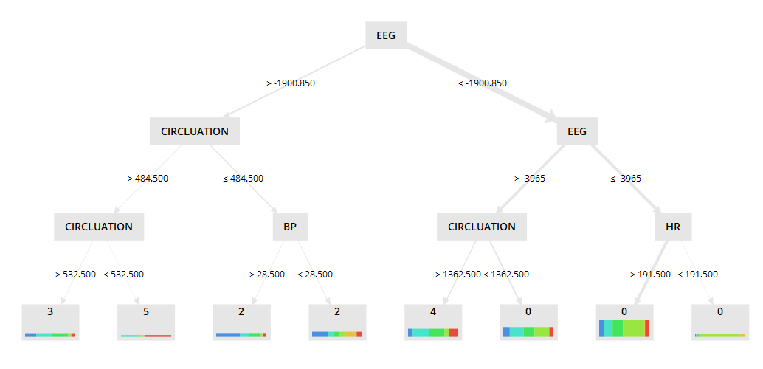
Decision tree
Tool
scikit-learn
Algorithm
CART (binary, post-pruning)
Performance
63.7% - 71.8%, rank: 2/7
Training time
<0.1s
Searching time
<1 hour

Slide 18
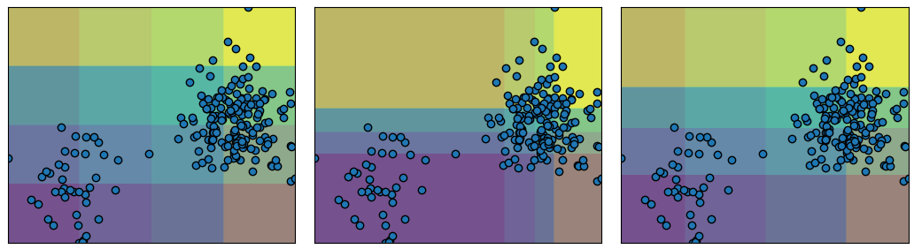
Preprocessing
Feature selection
embedded, 3 or 4 in 6
Normalization
no need
Outlier deletion
no need
Discretization
uniform, quantile, kmeans
SL | TIME | BP | CIRCLUATION | HR | EEG
0.210 | 0.093 | 0.121 | 0.234 | 0.225 | 0.118

Slide 19
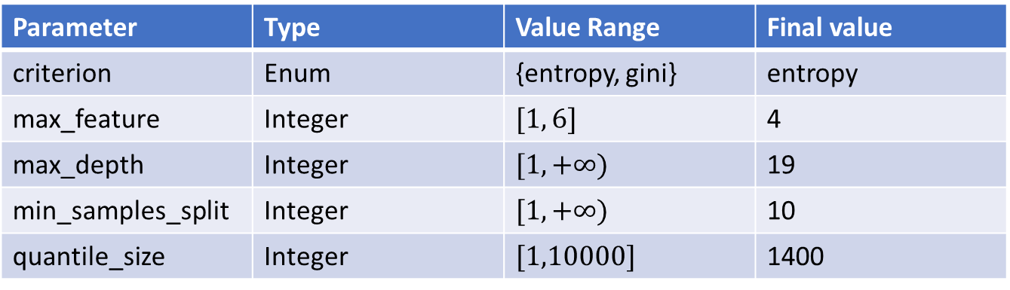
Hyperparameter
Grid Search about 100,000 runs
Parameter | Type | Value Range | Final value
criterion | Enum | {entropy, gini} | entropy
max_feature | Integer | $$[1, 6]$$ | 4
max_depth | Integer | $$[1, +∞)$$ | 19
min_samples_split | Integer | $$[1, +∞)$$ | 10
quantile_size | Integer | $$[1,10000]$$ | 1400

Slide 20
Conclusion
model | Best performance | Training time | Searching time
Support Vector Machine | 69.9% |  | several hours
Neural Network | 72% | 10 minute | few days
Decision Tree | 71.8% | 0.05 second | 1 hour
Support vector machine has opportunity to get good performance, but it rely on preprocessing very much.
Neural network has ability to achieve best performance without too much preprocessing, but its training and hyperparameter tuning may take a long time.
Decision tree is a very simple but powerful model for classification. It’s interpretable. But it’s hard to achieve best performance.

